Slide 1

Inventory management system
This Photo by Unknown Author is licensed under CC BY-NC

Slide 2

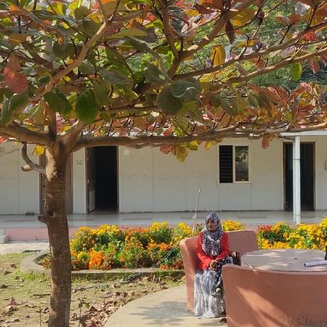
CONSULTANT
Md. Moshaidul Islam wdpf.idb-bisew it scholarship Email: moshaidul@gmail.com
FARHANA AKTER LUCKY
wdpf.idb-bisew it scholarship

Slide 3
Index
1 | Project Overview | 01
2 | Management | 02
3 | List of details | 03
4 | System configuration | 04
5 | Retail Management Challenges | 05
6 | ERD | 06
7 | Table | 07
8 | login Pannel | 08

Slide 4
Index
1 | DashBoard | 09
2 | Categories | 10
3 | Add product | 11
4 | System Configuration | 12

Slide 5
Md. Moshaidul Islam
Consultant
WDPF-IDB-BISEW
IDB Bhaban
Sher-e-Bangla Nagar, Dhaka
Subject: Management Web Application Project Proposal
Dear Sir
Thank you for offering me a great opportunity to make a real life project based on our core course that
is Web Development with PHP and Framework (WDPF). In this respect, I would like to inform you that I
have decided to make a project on Education Management System, which is most importance for every
business communities. I have studied about the various aspects of this system and make a proposal
accordingly which is enclosed herewith for your kind perusal. So, I think you will finally Approved the
project and help to utilize my creativity.
Sincerely
Rainbow Group

Slide 6
Project Overview
Administration and management of a departmental store is an essential part of the overall working and function of a departmental store. Particularly in the case of bigger stores, there will be several products and number of sections. So good and effective use of resources and effective management is necessary to the success and smooth working.

Slide 7

In this project we can manage ;
Purchase Record
Purchase Return Record
Purchase retail
Sales Record
Sales Return Record
Sales retails
Product Record
Categories retail
Dealer Record

Slide 8
List of Details
Add/Delete/Update the available product details.
Add/Delete/Update the customer details.
Delete/Update the description of new products.
Add/Delete/Update the employee details.
Add/Delete/Update the product categories.
All type of reports to the owner daily/weekly/monthly/yearly.
All the billing details.

Slide 9
S)+te (on,guration

;ard#are e7uirements

&rocessor < Intel= &entium= >

&rocessor speed < */+. G;?

;ard dis$ < Minimum >. GB

Main Memory < - GB

Monitor < (@( thin @ilm transistor

eyboard < Multimedia

Mouse < ptical or Scroll Mouse

C) )ri"e < )5) #riter

Soft#are e7uirements

@ront end Danguage' 8 5isual Basic 2/.

Bac$ end Danguage' 8 SED Ser"er

perating System < 9indo#s F&
10
SYSTEM CONFIGURATION
Hardware Requirements
Processor –Intel@ Pentium
Processor speed – 2.50 GHZ
Hard disk – Minimum 40 GB
Main Memory – 1GB
Monitor memory -1GB
Monitor TFT
Keyboard – multimedia
Mouse –Option or scroll Mouse
CD Drive – DVD writer

Slide 10
SYSTEM CONFIGURATION
Software Rquirements
Fornt end Language:Visual Basic 6.0
Back end Language : SQL Server
Operating System – Windows XP

Slide 11
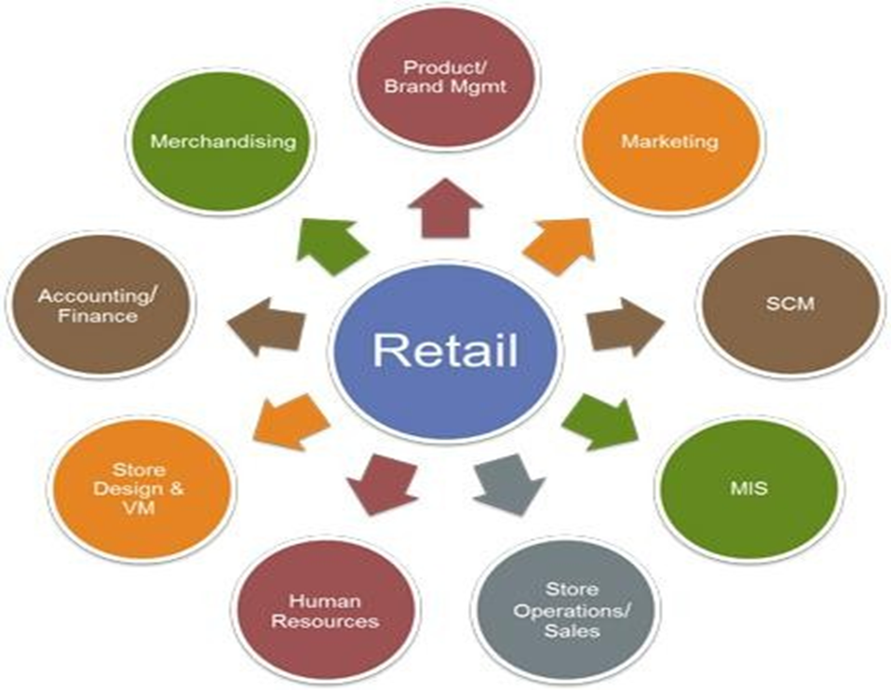
Retail Management Challenges

Slide 12
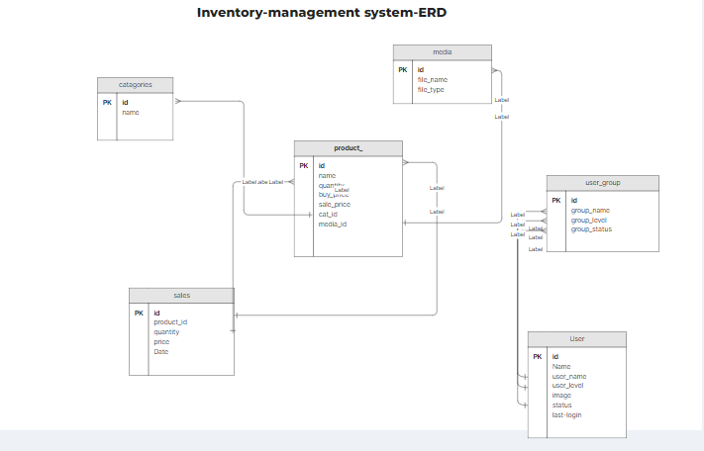
Inventory – Management System_ERD

Slide 13
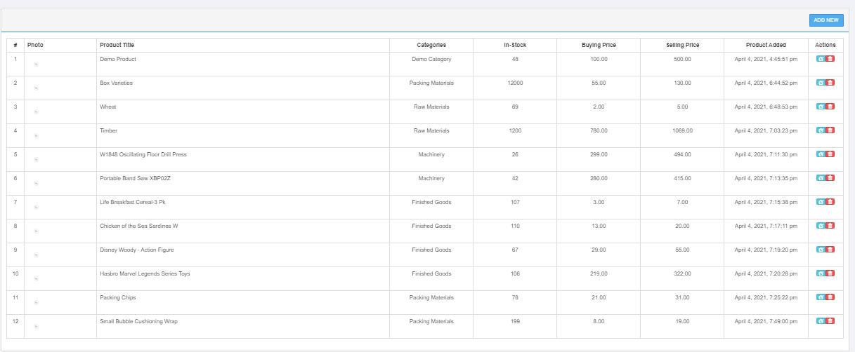
Table

Slide 14
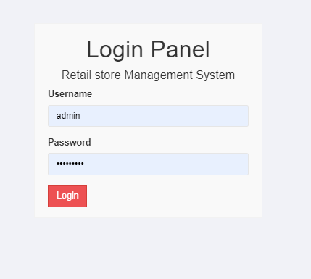
Login Pannel

Slide 15
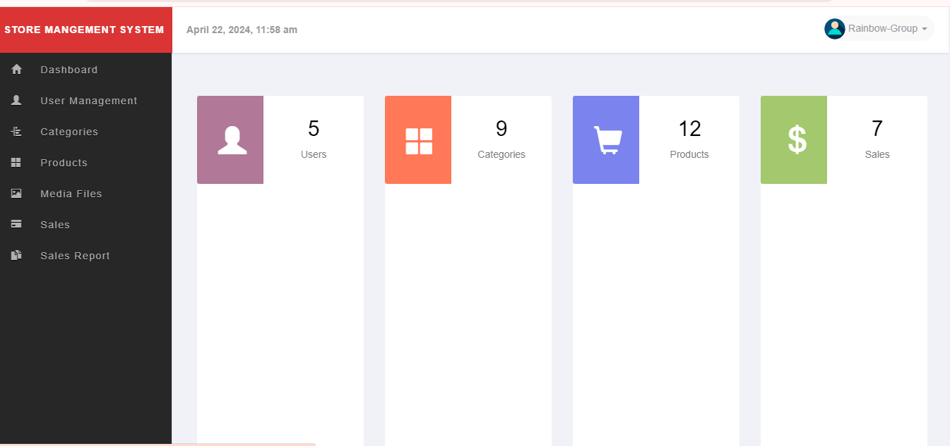
D A S H B O A R D

Slide 16
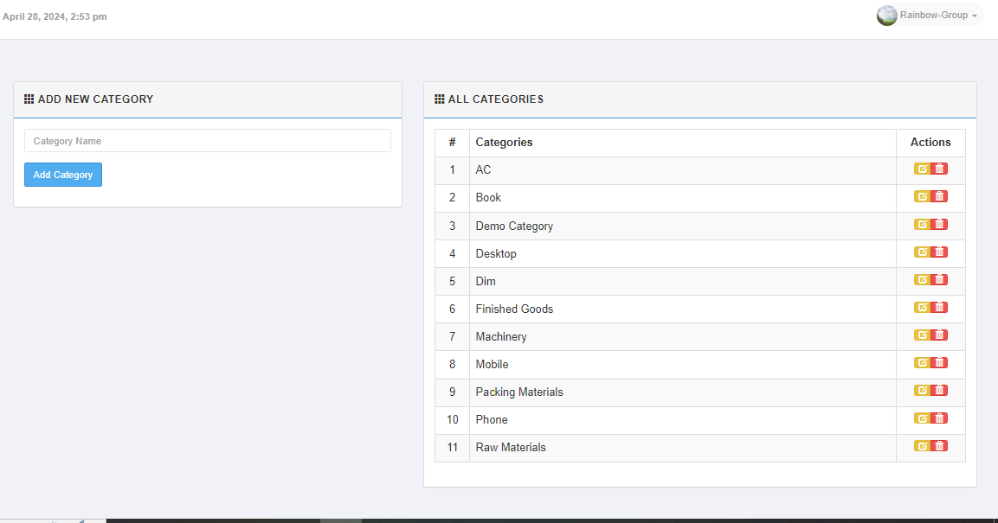
CATEGORIES

Slide 17
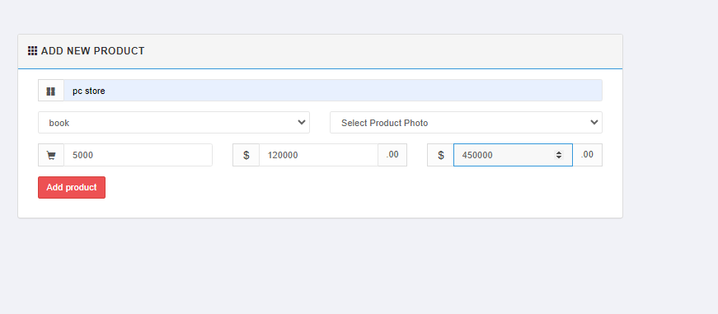
ADD PRODUCT

Slide 18



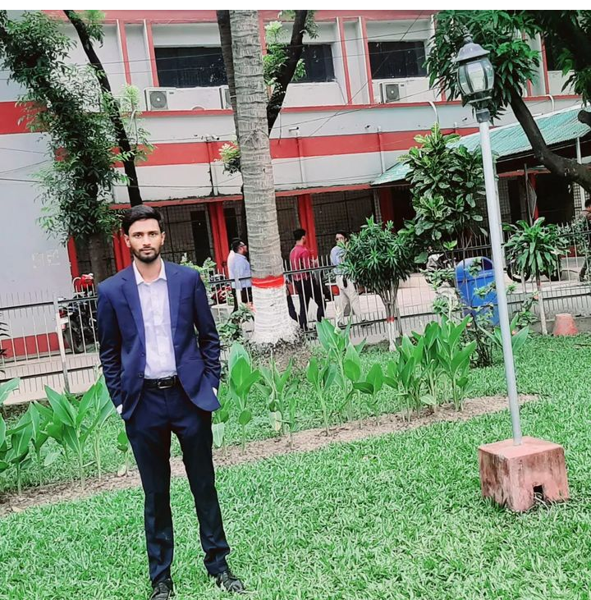
OUR TEAM MEMBERS
Shahriar Rahman Shakil
ID:1280737
Abdullah Al-Mamun
ID:1280023
Fima Akter Suma
ID:1279917
Rafia Khan Tuly
ID:1281130

Slide 19
Thank you
STAYING WITH US

